Slide 1

Monkey’s in Your Shopping
Chart
Donald Stegman, Godwin Thomas, Akuete Kpodar, Hena Venu

Slide 2
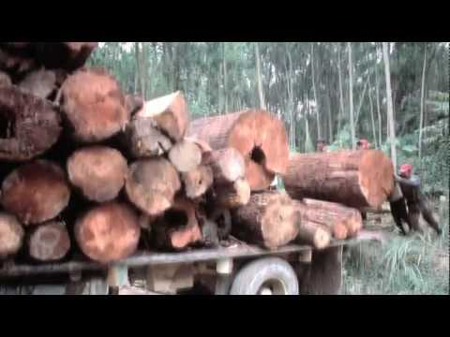

Slide 3

Threats to the Orangutan Population
We can’t control:
Urban development
Hunting & Trafficking
In the US we can impact:
Palm Oil Production & Deforestation by lumber mills

Slide 4
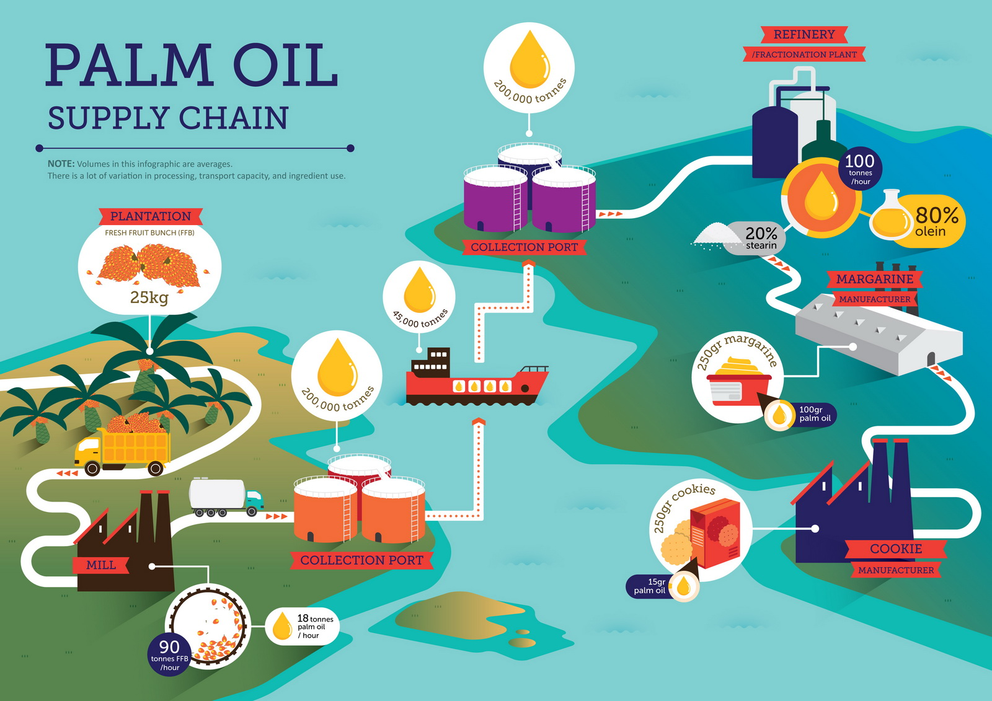
How does palm oil make it into your house and the products you buy?
More info?
Find it here.

Slide 5
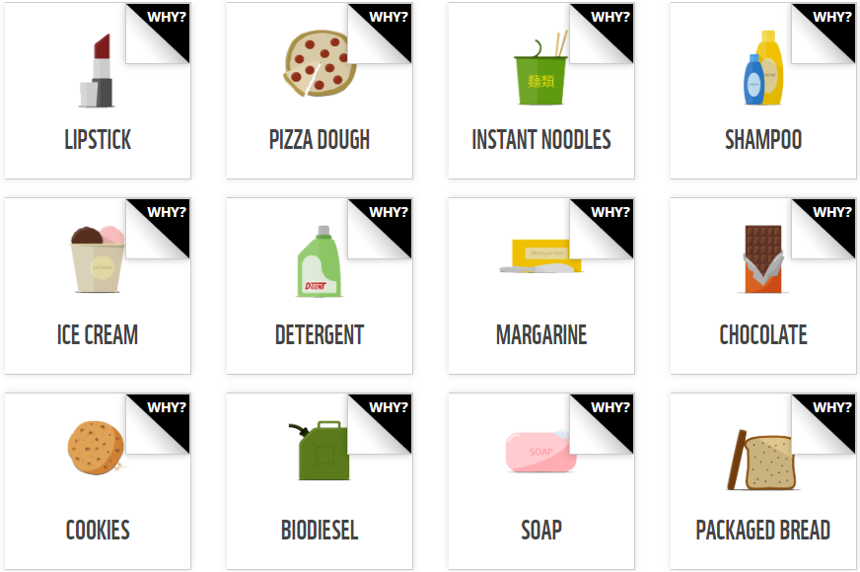
I had know idea palm oil was an important ingredient in so many products!
More info?
Find it here.

Slide 6

How can we help save these majestic creatures?
Look for products containing
these symbols:
More infomation about being a responsible consumer can be found here.

Slide 7


Adopt your own Orangutan
Adopt a plush animal to support the
World Wildlife Foundation here.

Slide 8
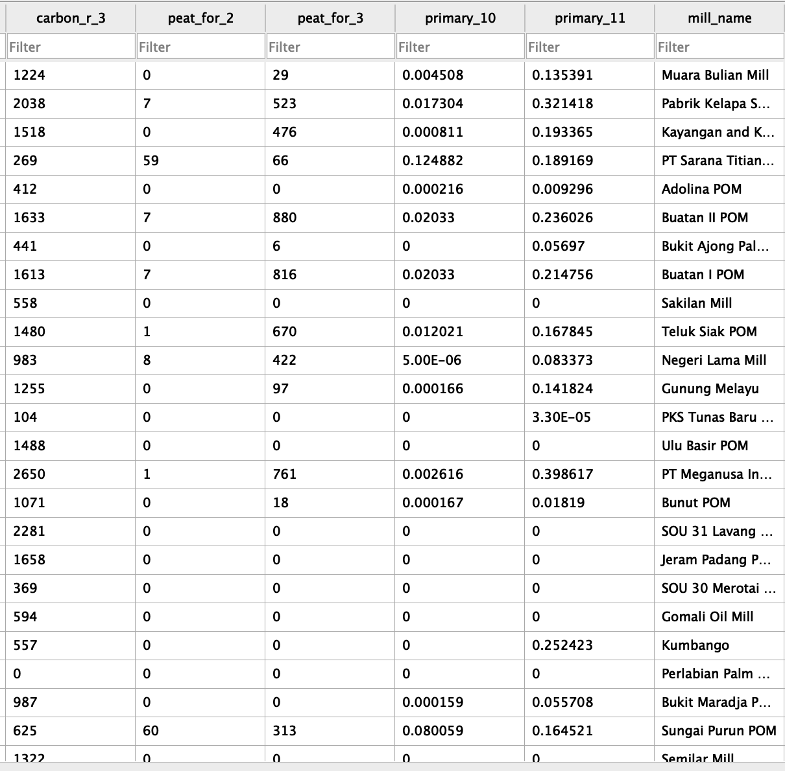
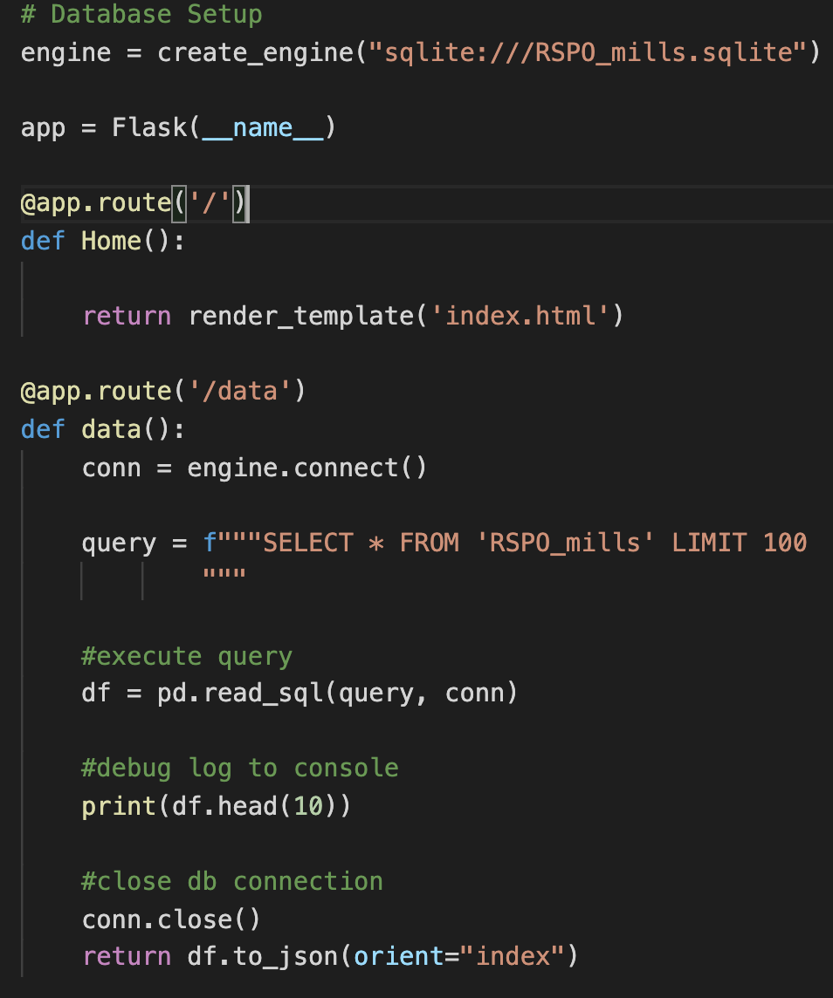

Slide 9
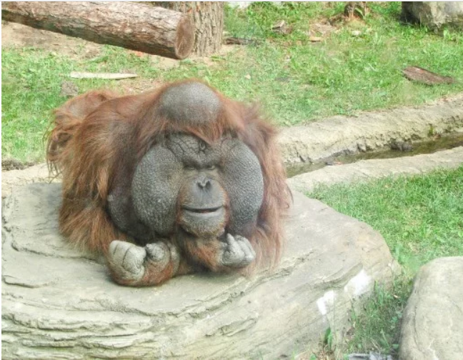
Let’s see the
site!
Our site can be found here.
Our site can be found here.

Slide 10
Sources
CSV: Carbon Emissions from Palm Oil Mills
http://data.globalforestwatch.org/datasets/683f1bb1d88e4fe99df38e3e60b1d0d8_6
Shape Files: Mill Locations; Orangutan Locations
http://datasets.wri.org/dataset/683f1bb1d88e4fe99df38e3e60b1d0d8_6
API access: Mill Data
http://data.globalforestwatch.org/datasets/universal-mill-list?geometry=84.264%2C-7.593%2C139.504%2C7.742

